Slide 1
OPCODER
Traffic Light System
Miguel Antonio Rodriguez Delgado
Marwa Mohammed Nabawey Hassan
Vincent Chinedu Obigwe
Abeeb Opeyemi Nureni
Charles Arsenal Okere
Amit Chakma

Slide 2
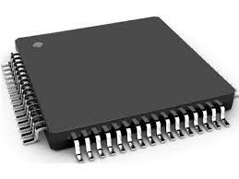
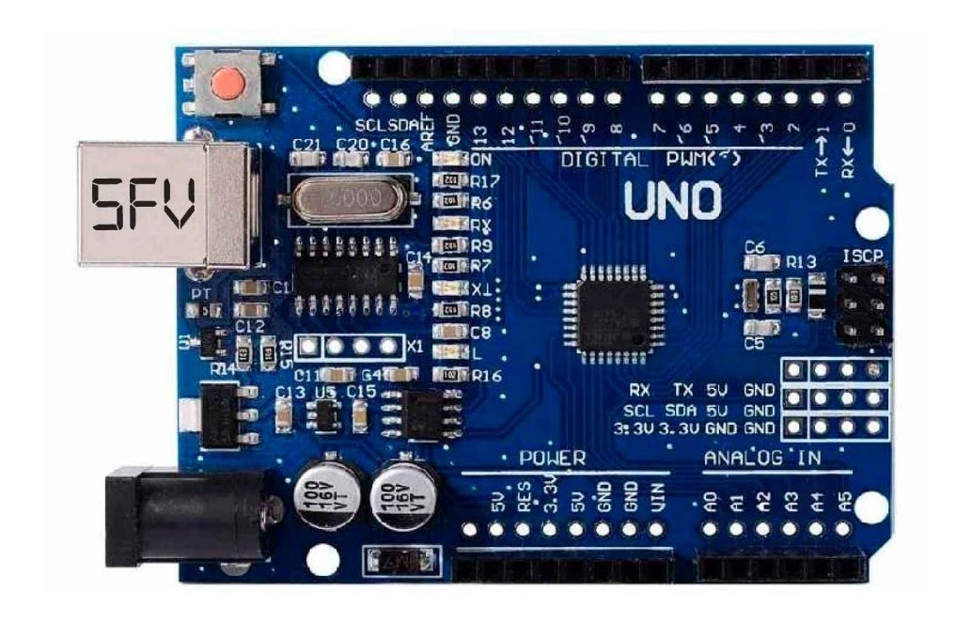
Basic Elements
Microcontroller
Arduiono Uno

Slide 3
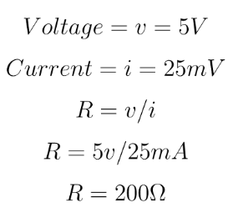
Basic Elements
Resistors
LEDs
Buttons

Slide 4
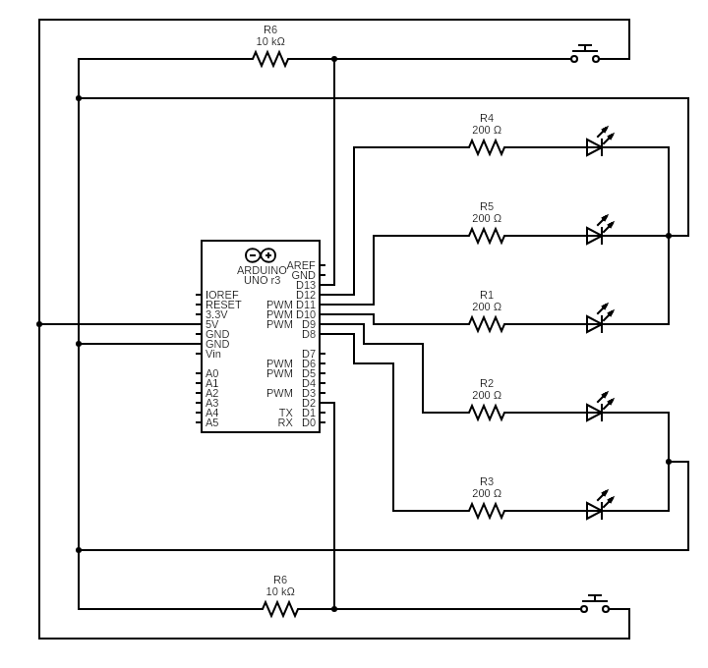
Electrical Circuit

Slide 5
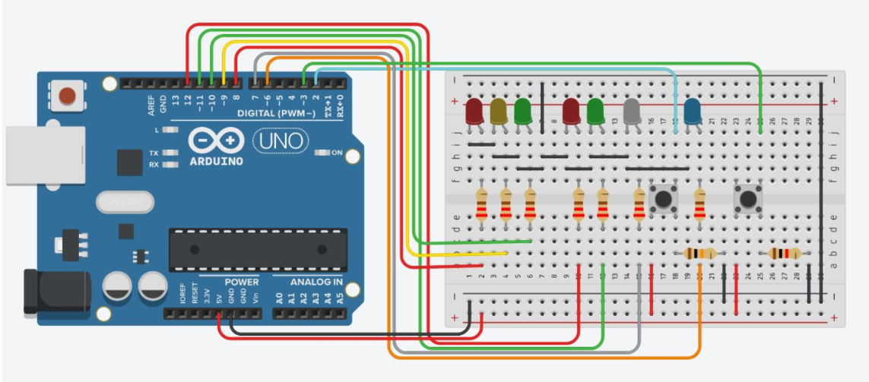
Arduino Circuit

Slide 6
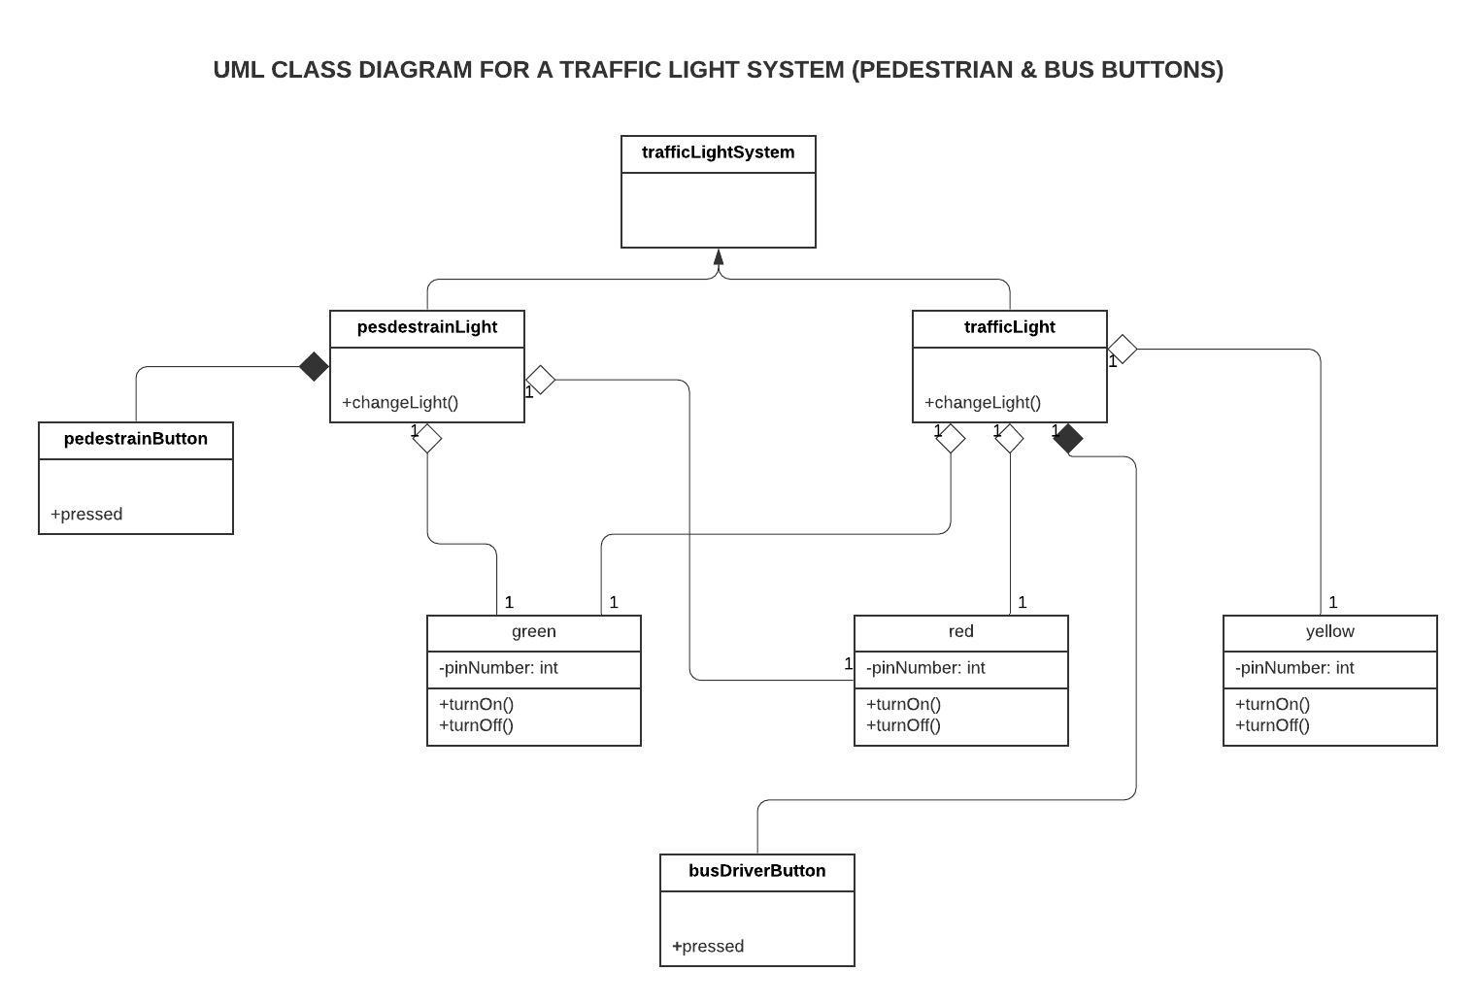
Class Diagram

Slide 7
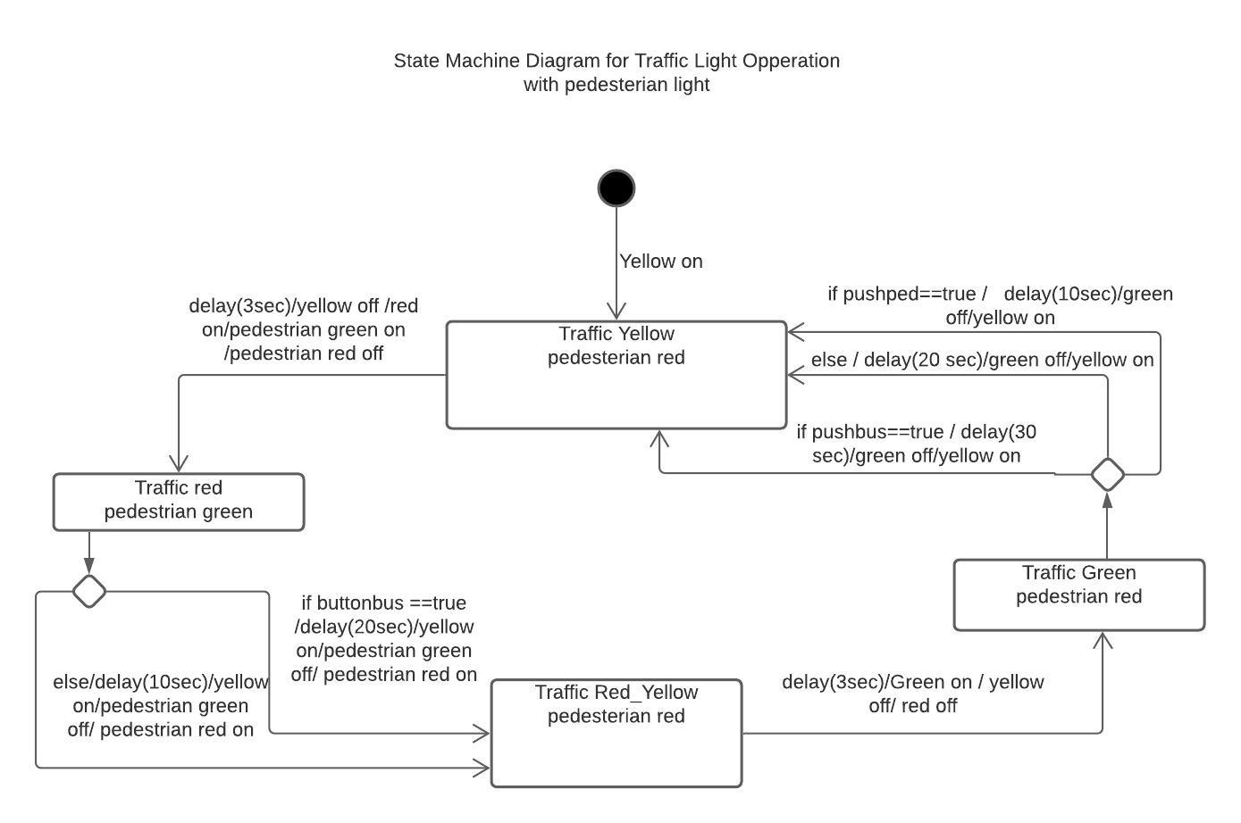
State Machine Diagram

Slide 8
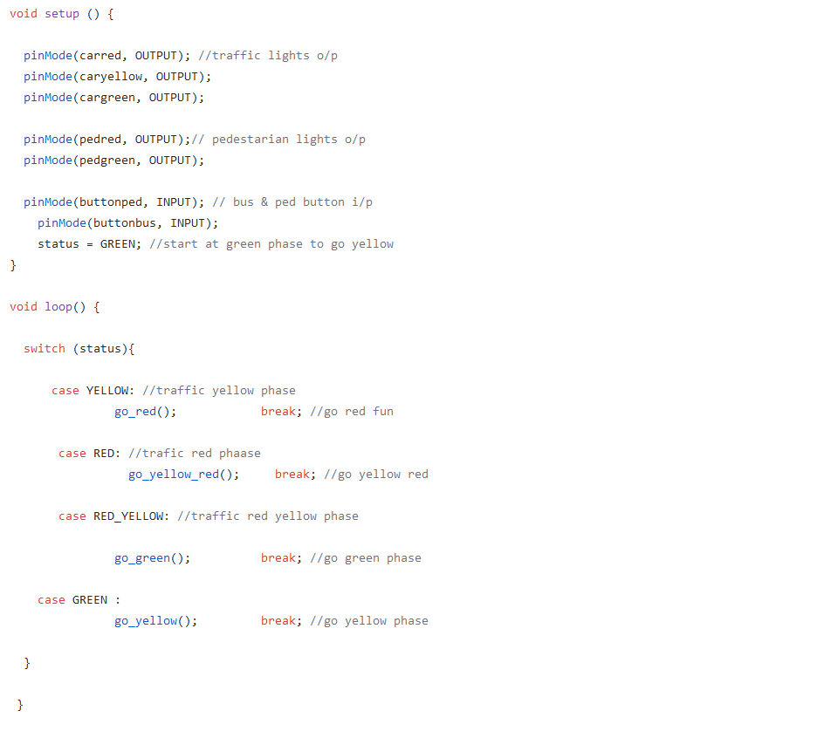
Coding Synchronous

Slide 9
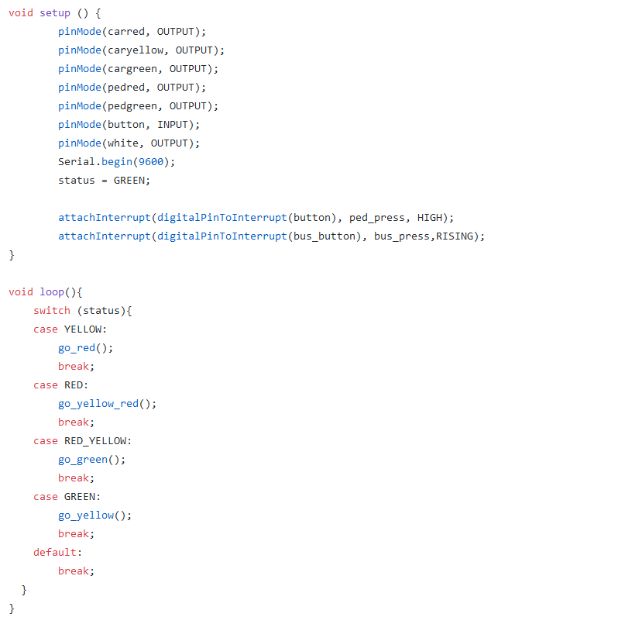
Coding Asynchronous

